Slide 1

New Jersey Center for Teaching and Learning
Progressive Mathematics Initiative
This material is made freely available at www.njctl.org and is intended for the non-commercial use of students and teachers. These materials may not be used for any commercial purpose without the written permission of the owners. NJCTL maintains its website for the convenience of teachers who wish to make their work available to other teachers, participate in a virtual professional learning community, and/or provide access to course materials to parents, students and others.
Click to go to website
www.njctl.com

Slide 2
Parallel and Perpendicular Lines
www.njctl.org

Slide 3
Setting the PowerPoint View
Use Normal View for the Interactive Elements
To use the interactive elements in this presentation, do not select the Slide Show view. Instead, select Normal view and follow these steps to set the view as large as possible:
On the View menu, select Normal.
Close the Slides tab on the left.
In the upper right corner next to the Help button, click the ^ to minimize the ribbon at the top of the screen.
On the View menu, confirm that Ruler is deselected.
On the View tab, click Fit to Window.
Use Slide Show View to Administer Assessment Items
To administer the numbered assessment items in this presentation, use the Slide Show view. (See Slide 10 for an example.)

Slide 4
Table of Contents
Angles and Parallel Lines
Constructing Parallel Lines
Equations of Lines and Slope
Slopes of Parallel Lines
Perpendicular Lines and Angles
Constructing Perpendicular Lines
(including shortest distance from a point to a line)
Slopes of Perpendicular Lines
Proofs Involving Parallel and Perpendicular Lines

Slide 5
Angles and Parallel Lines
Return to Table
of Contents

Slide 6
There are two different ways to draw 2 lines in the same plane:
k
m
Those two lines will meet eventually because any line can be extended in two directions without ending.
Two lines in a plane that never meet are called parallel lines.
Two lines in a plane that have exactly one common point are called intersecting lines.

Slide 7
There are two different ways to draw 2 lines in the same plane
:
k
n
m
p
Definition of
Parallel Lines
Two lines are parallel if and only if they are in a same plane and do not intersect.
n
p
Definition of
Intersecting Lines
Two lines are intersecting if and only if they are in a same plane and intersect at one point.

Slide 8
There are two different ways to draw
2 lines in the same plane
k
n
m
p
Parallel lines are always coplanar.
In geometry, the symbol II
n
means is parallel to .
p
k || m means line k is parallel to line m.
The red arrows on the diagram indicate that lines are parallel.
Intersecting lines are always coplanar.
n || p means line n is not parallel to line p.

Slide 9
Sometimes lines that do not intersect are not in the same plane. Those are called skew lines.
a
G
b
Definition of
Skew Lines
Two lines that are not in the same plane are skew if and only if they do not intersect.

Slide 10
1
Name all lines parallel to EF.
H
G
A
AB
E
F
B
BC
C
DC
D
D
HD
C
E
HG
A
B

Slide 11
2
Name all lines skew to EF.
H
G
A
BC
E
DC
F
B
C
HD
D
D
AB
C
E
GC
A
B

Slide 12
3
Two intersecting lines are always coplanar.
True
False

Slide 13
4
Two skew lines are coplanar.
True
False

Slide 14
5
Complete this statement with the best appropriate word: Two skew lines are ... parallel.
A
always
B
never
C
sometimes

Slide 15
In geometry, a line that intersects two or more lines at different points is called transversal.
Definition of
Transversal
In a plane, a line is a transversal if and only if it intersects two or more lines, each at a different point.
The lines cut by a transversal may or may not be parallel.
n
n
k || m
k || m
2
1
2
1
3
4
k
3
4
k
6
5
6
5
7
8
m
7
8
m
n is a transversal for k and m.

Slide 16
When transversal intersects two lines, eight angles are formed. These angles are given special names.
n
2
1
3
4
k
Interior angles, that lie between the two lines, are:
6
5
,
4
5
6
m
3
,
,
7
8
Exterior angles, that lie outside the two lines, are:
1, 2, 7, 8
Alternate interior angles are two angles on opposite sides of the transversal:
3 and 5, 4 and 6
Alternate exterior angles are two angles on opposite sides of the transversal:
1 and 7, 2 and 8

Slide 17
Same-side(consecutive) interior angles are two angles on the same side of the transversal:
∠3 and ∠ 6, ∠ 4 and ∠ 5
Corresponding angles are two angles in corresponding positions relative to the two lines:
∠2 and ∠6, ∠ 1 and ∠ 5, ∠ 3 and ∠ 7, ∠ 4 and ∠ 8
n
2
1
3
4
k
6
5
7
8
m

Slide 18
Classify each pair of angles as alternate interior, same-side interior,
corresponding angles, or none of these.
a. 7 and 12
b. 3 and 6
c. 6 and 11
d. 7 and 11
e. 4 and 10
f. 14 and 16
g. 2 and 3
h. 2 and 10
3
4
1
2
7
8
5
6
11
12
9
10
15
16
13
14
alternate interior
alternate interior
alternate interior
alternate interior
alternate interior
alternate interior
alternate interior
alternate interior
alternate interior
alternate interior
alternate interior
alternate interior
alternate interior
alternate interior
alternate interior
alternate interior
alternate interior
alternate interior
alternate interior
alternate interior
corresponding
corresponding
corresponding
corresponding
corresponding
corresponding
corresponding
corresponding
corresponding
corresponding
corresponding
corresponding
corresponding
corresponding
corresponding
corresponding
corresponding
corresponding
corresponding
corresponding
same-side interior
same-side interior
same-side interior
same-side interior
same-side interior
same-side interior
same-side interior
same-side interior
same-side interior
same-side interior
same-side interior
same-side interior
same-side interior
same-side interior
same-side interior
same-side interior
same-side interior
same-side interior
same-side interior
same-side interior
same-side interior
none of these
none of these
none of these
none of these
none of these
none of these
none of these
none of these
none of these
none of these
none of these
none of these
none of these
none of these
none of these
none of these
none of these
none of these
none of these
none of these

Slide 19
Properties of Parallel Lines.
Corresponding Angles
Postulate
If two parallel lines are cut by transversal, then corresponding angles are congruent.
k || m
n
2
1
2 ≅ 6 1≅ 5 3≅ 7 4 ≅ 8
3
4
k
6
5
m
m ∠ 8 = 114⁰
7
8
Answer
Example. If m ∠ 4=114⁰, find the measure of ∠ 8. Explain your answer.

Slide 20
Properties of Parallel Lines.
Alternate Interior
Angles Theorem
If two parallel lines are cut by transversal, then alternate interior angles are congruent.
n
3 ≅ 5 4 ≅ 6
k || m
2
1
3
4
k
6
5
7
8
m
Example. If m∠ 3 = 63⁰, find the measure of ∠ 5. Explain your answer.
m∠5 = 63⁰
Answer

Slide 21
Properties of Parallel Lines.
Alternate Exterior
Angles Theorem
If two parallel lines are cut by transversal, then alternate exterior angles are congruent.
n
k || m
2≅ 8 1≅ 7
2
1
k
3
4
6
5
m
7
8
Example. If m 2=108⁰, find the measure of 8. Explain your answer.
m∠ 8=108⁰
Answer

Slide 22
Properties of Parallel Lines.
Same-side
Angles Theorem
If two parallel lines are cut by transversal, then same-side angles are supplementary.
n
m ∠ 3 + m ∠ 6 = 180⁰
m ∠ 4 + m ∠ 5 = 180⁰
k || m
2
1
k
3
4
6
5
m
7
8
Example. If m ∠ 3 = 63⁰, find the measure of ∠ 6. Explain your answer.
m 6 = 117⁰
Answer

Slide 23
6
If m ∠ 4=116⁰, then find the measure of ∠ 9.
k || m
n
p
n || p
2
1
10
9
k
3
4
11
12
6
5
14
13
m
7
8
15
16

Slide 24
7
If m ∠ 15 = 57°, then find the measure of ∠ 2.
k || m
n
p
n || p
2
1
9
10
k
3
4
11
12
6
5
14
13
m
7
8
15
16

Slide 25
Example. Find measure of ∠ 1.
131⁰
1
41⁰

Slide 26
8
Find m 1.
1
126⁰
110⁰

Slide 27
9
What statement would always make line k and m parallel?
n
k
A
m ∠2 = m ∠4
1
2
4
m
B
m ∠ 5 + m ∠ 6 = 180°
3
C
m ∠ 3 = m ∠ 5
5
D
m ∠ 1+ m ∠ 5 = 90°
6
8
7

Slide 28
Example. Find the values of x and y.
132⁰
(4y+12)⁰
x⁰

Slide 29
Example. Find the values of x,y, and z.
(14x+6)⁰
66⁰
2z⁰
(3y -6)⁰

Slide 30
10
Find value of x.
54⁰
(3x)⁰

Slide 31
11
Find the value of x.
2x-3
4x-61

Slide 32
12
Find value of x.
122⁰
(16x+10)⁰

Slide 33
Constructing Parallel Lines
Return to Table
of Contents

Slide 34
Try the following question. Be ready to explain your choice.
13
Based on the diagram below, which statement is true?
e
f
g
A
h || i
123⁰
h
B
e|| f
64⁰
57⁰
C
f || g
D
e|| g
i
132⁰
×
In the preceding section you saw that when two lines are parallel, you can conclude that certain angles are congruent or supplementary. In this section the situation is reversed.

Slide 35
Postulate
(Converse of Corresponding
Angles Postulate)
If two lines are cut by transversal and corresponding angles are congruent, then the lines are parallel.
n
k || m
2
1
2 ≅ 6 1 ≅ 5 3 ≅ 7 4 ≅ 8
3
k
4
6
5
m
7
8
Example. If m ∠ 3 = 56⁰, find the measure of ∠ 7 that makes lines k and m parallel. Explain your answer.
m ∠ 7 = 56⁰
Answer

Slide 36
Theorem
(Converse of Alternate Interior Angles Theorem)
If two parallel lines are cut by transversal and alternate interior angles are congruent, then the lines are parallel.
n
k || m
If ∠3 ≅ ∠ 5 and ∠4 ≅ ∠ 6 , then k || m
2
1
k
3
4
6
5
m
7
8
Example. If m∠ 4 = 110⁰, find the measure of ∠ 6 that makes lines k and m parallel. Explain your answer.
m∠ 6 = 110⁰
Answer

Slide 37
Theorem
(Converse of Alternate Exterior Angles Theorem)
If two parallel lines are cut by transversal and alternate exterior angles are congruent, then the lines are parallel.
n
k || m
If ∠2 ≅ ∠ 8 and ∠1 ≅ ∠ 7 , then k || m
2
1
3
k
4
6
5
m
7
8
Example. If m∠ 1 = 48⁰, find the measure of ∠ 7 that makes lines k and m parallel. Explain your answer.
m ∠ 7=48⁰
Answer

Slide 38
Theorem
(Converse of Same-side Angles Theorem)
If two parallel lines are cut by transversal and same-side interior angles are supplementary, then the lines are parallel.
n
If m ∠ 3 + m ∠6 = 180⁰ and m∠ 4 + m∠ 5 = 180⁰
k || m
,
2
1
then k||m
3
k
4
6
5
m
7
8
Example. If m ∠ 5 = 54⁰, find the measure of ∠ 4 that makes lines k and m parallel. Explain your answer.
m∠ 4 = 126⁰
Answer

Slide 39
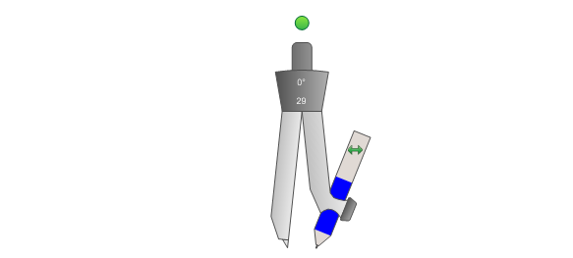


When you're asked to construct a line through a point parallel to a given line, you are going to use three different methods. You could either choose corresponding angles, alternate interior angles or alternate exterior angles.
Method 1. Corresponding angles.
C
Given: Line AB and point C not on the line.
A
B
Step 1. Draw a transversal to the line AB through point C that intersects line AB at point D. An acute angle with point D as a vertex is formed (the measure of the angle is not important).
C
A
D
B
Step 2. Center the compass at point D and draw an arc to intersect both lines. Using the same radius of compass, center it at point C and draw another arc.
C
A
D
B

Slide 40
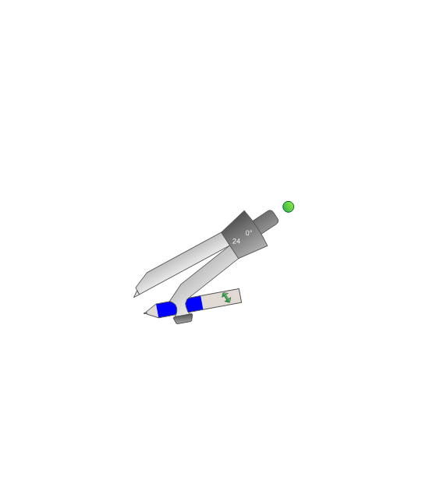
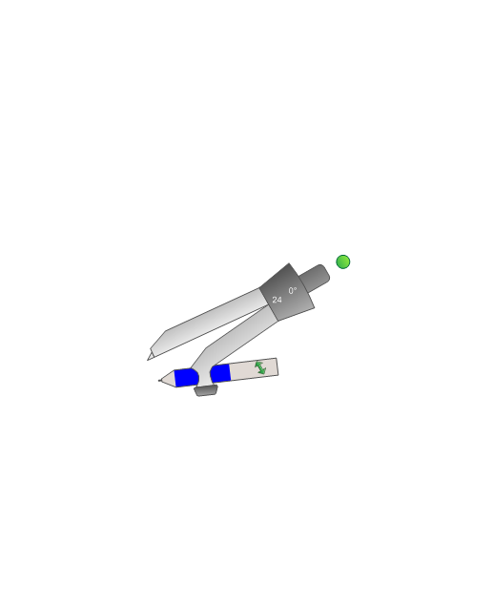



Step 3. Set the compass radius to the distance between the two intersection points of the first arc. Then center the compass at the point F where the second arc intersects line DC. Mark the arc intersection point E. Use a ruler to join C
and E and draw the line.
F
C
C
E
A
D
B
A
D
B
F
∠CAB and ∠ FCE are corresponding angles
and ∠CAB ≅ ∠FCE, then AB||CE
C
E
A
D
B

Slide 41

Method 2. Alternate interior angles.
C
Given: Line AB and point C not on the line.
A
B
Step 1. Draw a transversal to the line AB through point C that intersects line AB at point D. An acute angle with point D as a vertex is formed(the measure of the angle is not important).
×
C
A
D
B
Step 2. Center the compass at point D and draw an arc to intersect both lines. Using the same radius of compass, center it at point C and draw another arc.
C
A
D
B

Slide 42


×
Step 3. Set the compass radius to the distance between the two intersection points of the first arc. Then center the compass at the point F where the second arc intersects line DC. Mark the arc intersection point E. Use a ruler to join C and E and draw the line.
E
C
F
A
D
B
E
C
∠CAB and ∠FCE are alternate interior angles
and ∠CAB ≅ ∠FCE, then AB||EC
F
A
D
B

Slide 43

Method 3. Alternate exterior angles angles.
( try on your own )
C
A
B

Slide 44
14
What theorem would prove that lines a and b are parallel?
A
When two lines are cut by transversal and corresponding angles are congruent, then these two lines are parallel.
When two lines are cur by transversal and alternate interior angles are congruent, then those two lines are parallel.
B
C
When two lines are cut by transversal and same-side interior angles are complementary, then these lines are parallel.
D
When two lines are cut by transversal and same-side interior angles are supplementary, then these lines are parallel.
a
b

Slide 45
15
Find the value of x for which a||b.
(6x-20)⁰
a
2x⁰
b
4x⁰

Slide 46
Real-life problem. The rectangular frame for a picture or painting is made of 4 pieces that have the corners are cut to form 45⁰ angles. Why is it constructed this way?

Slide 47
Equations of Lines and Slope
Return to Table
of Contents

Slide 48
You definitely remember an important theorem from Unit 1:
Through any two points in a plane there
can be drawn one and only one line.

Slide 49
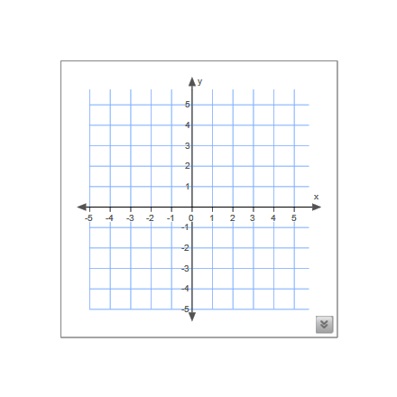
From Algebra you remember that you can locate points on
xy-coordinate plane. To set up a plane rectangular coordinate system, draw two number lines, or axes, meeting at right angles at point O, the origin. The horizontal axis is called the x-axis, and the vertical axis, the y-axis. The axis divide the plane into four quadrants.
Y-AXIS
Second
Quadrant
First
Quadrant
ORIGIN
X-AXIS
Third
Quadrant
Fourth
Quadrant
A rectangular coordinate system is sometimes called a Cartesian coordinate system in Honor of Rene Descartes(1596-1650), the French mathematician who introduced coordinates.

Slide 50
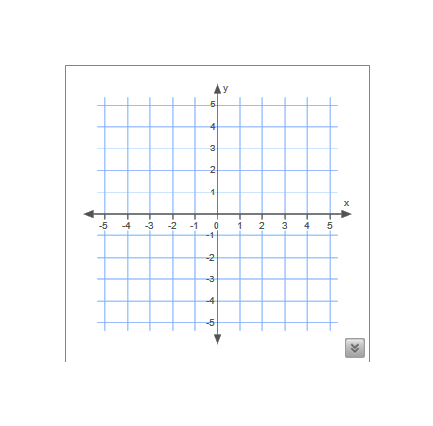
Any point in the coordinate plane is represented by ordered pair of numbers. For instance, let point A to be represented by the pair (-2,3). We would like
to graph the ordered pair (-2,3) or, in different words, to plot the point A. The first number in the pair -2 identifies the horizontal coordinate, is called
x-coordinate, or abscissa of point A. The second number in the pair 3 identifies the vertical coordinate, is called y-coordinate, or ordinate of point A.
x-coordinate
(-2,3)
A
y-coordinate
The x-coordinate always comes first in an ordered pair - it is very easy to remember: it is in an alphabetical order - x comes before y.

Slide 51
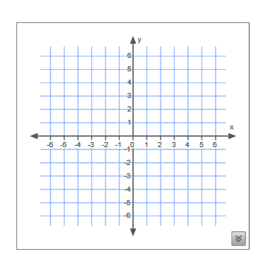
Example. Graph two ordered pairs: (-2,-3);(1,3)

Slide 52
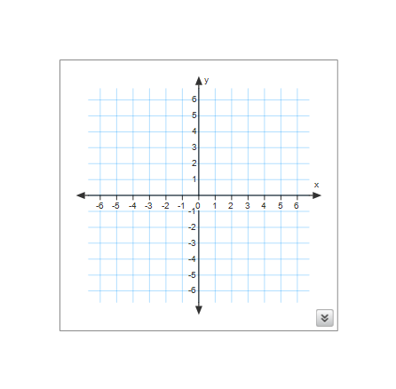
Now we are able to connect these points. You may notice that there some other points are on this line, such as (-1,-1),(2,5). Actually there are infinite number of points that lie on the same line.
(1,3)
(-2,-3)

Slide 53
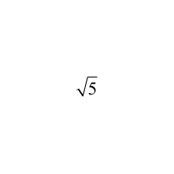
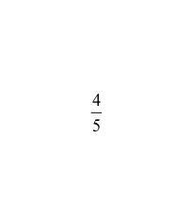
Every line in the coordinate plane is presented by equation in a form
Ax + By= C ( A and B not both 0)
This equation is called a linear equation in two variables in a standard form.
Examples of the linear equations:
3x +4y =5 -4.7x + 12y = - 11
3y=x-21
x= -4y+22
x +
y =
54
Note: A,B, and C may be positive, negative numbers, decimals, or fractions. It is not important. It is important that variables x and y will
be raised to a power with a degree equals to 1(x¹=x, y¹=y).

Slide 54
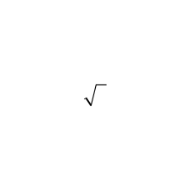
16
Which one from the given equations is an equation of a line?
2
A
12x - 10y = 5
B
2x =- 3y + 6
C
3x +4 y =11
D
2 + 5y = - 6
__
x

Slide 55
17
Which one from the given equations is NOT an equation of the line?
A
2.3x – y = 15
B
y = -2/7x – 12
C
3x + 5/y = 23
D
4y - 15x +3 = 0

Slide 56
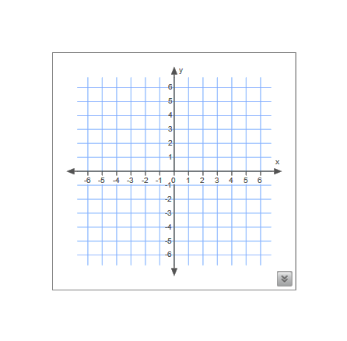
Now lets get back to the given line that passes through two given points (-2,-3) and (1,3).
How do we write a linear equation for this line?
First, lets draw a few more lines in the same coordinate plane.
(1,3)
(-2,-3)

Slide 57
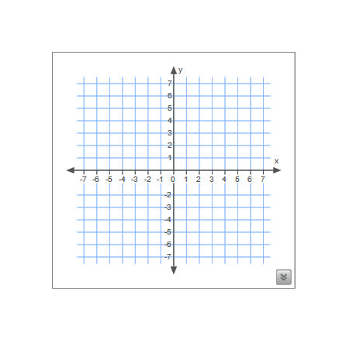
Explain, what is a difference between all those lines.

Slide 58
The main characteristic of the line in the coordinate pane it's steepness. In mathematics the steepness of a line is called slope.
Vertical change
Slope =
Horizontal change
(1,3)
Vertical change is often called rise.
Horizontal change is often called run.
Letter m is usually used to represent a slope.
Slope can also be thought of as the rate of change.
(-2,-3)
Lets figure out rise and run for the given line.
Rise = 6 Run= 3
m = 6 = 2
3

Slide 59
You may wonder what is going to happen if we will use two different points on the line, like (-3,-5) and (2,5).
Look, what happened.
Rise = 10 Run= 5
m = 10 = 2
5
(2,5)
(1,3)
Slope is still the same!
(-2,-3)
(-3,-5)
Note. You can pick any two points
on the line to form a right triangle to figure out a slope of the given line.

Slide 60
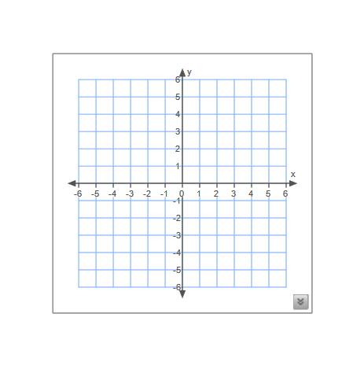
Now explain the difference between blue and red line.
A line that rises as you move from left to right has a positive slope.
A line that falls as you move from left to right has a negative slope.

Slide 61
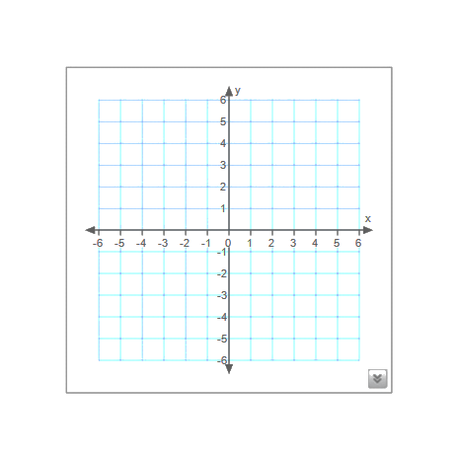
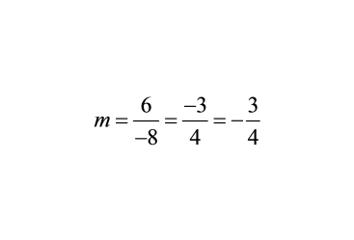
Now we will try to find a slope for a blue line.
Blue line falls!
It has a negative slope.

Slide 62
Vertical change can be written
as a difference in vertical, y-coordinates: y₂-y_{1.}
Horizontal change can be written
as a difference in horizontal, x-coordinates: x₂-x₁.
Vertical change
Slope =
Horizontal change
y₂ -y₁
Slope =
x₂-x₁
3 - (-3) 6
m = = = 2
1 - (-2) 3
(1,3)
(-2,-3)
Note. It is not important which point you will label as first, or second. You will always achieve the same result.
m = -3 – 3 = -6 = 2
-2 – 1 -3

Slide 63
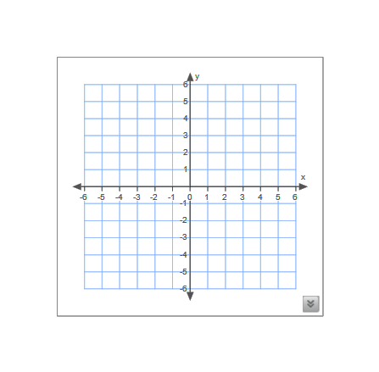
Horizontal lines have no change in vertical coordinates.
Horizontal lines have slopes equal 0.
3 – 3 0
m = = = 0
-2 – 1 -3
Red line slope:
(-2,3)
(1,3)
-4 – (-4) 0
m = = = 0
3 – (-3) -3
Green line slope:
(-3,-4)
(3,-4)

Slide 64
Vertical lines have no change in horizontal coordinates.
Slope of the vertical line is undefined.
3 – (-2) 5
m = =
2 – 2 0
Red line slope:
(-4,4)
(2,3)
4 – (-3) 7
m = =
4 – (-4) 0
Green line slope:
(2,-2)
(-4,-3)

Slide 65
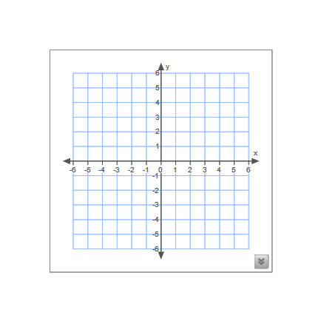
18
Identify the slope of the given line.
A
3
B
0
C
1/3
D
-3

Slide 66
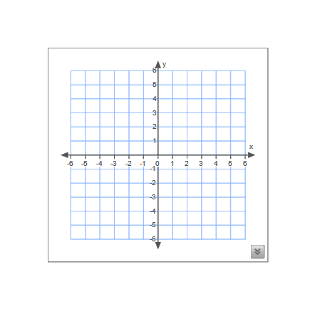
19
Identify the slope of the given line.
A
4
B
-1/4
C
undefined
D
1/4

Slide 67
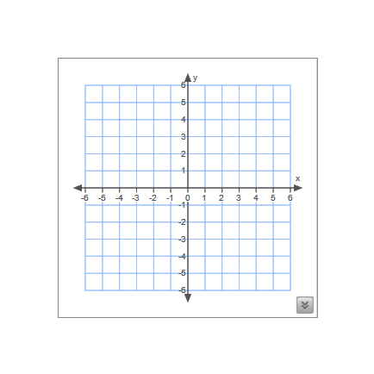
20
Identify the slope of the given line.
A
undefined
B
3
C
-3
D
0

Slide 68
21
Identify the slope of the line containing the given points: (-4, 2),( 3,2)
A
undefined
B
7
C
0
D
1/7

Slide 69
22
Identify the slope of the line containing the given points: (6, -12), (0,0)
A
-1/2
B
0
C
-2
D
2

Slide 70
23
Identify the slope of the line containing the given points: (-5,3),(-5,-3)
A
-6
B
undefined
C
0
D
-5

Slide 71
24
Identify the slope of the line containing the given points: (4,7), (10, 4)
A
-2
B
1/2
C
0
D
-1/2

Slide 72
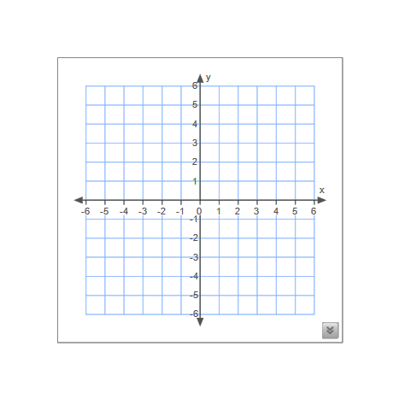
So, now we know, that the slope tells us the way any line goes. Compare the slopes of two given lines. Identify their slopes.
Two different lines have the same slope 1/2 .
How can we distinguish between those two line? How can we identify them as unique set of points?
Rise = 2
Run = 4
Rise = 2
Run = 4

Slide 73
Notice, that those two lines with the same slope pass through different point in the coordinate plane. We remember that each line in the plane is presented by the linear equation. In order to write the equation for the given line you have to know
Point-slope formula, which is
y – y₁= m(x – x₁)
where m is a slope, and (x₁,y₁) are coordinates for a point on a line.
(3,3)
So, let write an equation for a red line.
1
2
m= __ , point (3,3)
y – 3 = (x – 3)
1
2
(1,-2)
Then we simplify an equation in order
to write a linear equation in a standard form.
y – 3 = x –
- x + y =
1
2
3
2
1
2
3
2

Slide 74
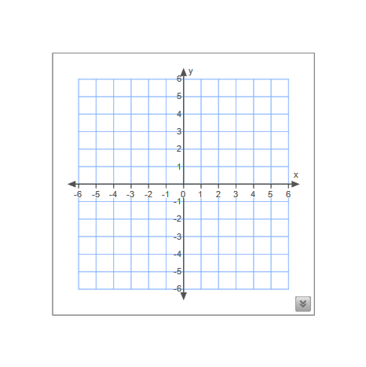
Now try to write an equation for a blue line yourself.
1
2
m = , point (1,-2)
y – (-2) = (x-1)
Then we simplify an equation in order to write in a standard form.
y + 2 = x –
- x + y = -
(3,3)
1
2
(1,-2)
1
2
1
2
1
2
5
2

Slide 75
Example. Write an equation for the given line in standard form using any of the points on a line.
(use a point-slope formula)
(1,3)
(-2,-3)

Slide 76
You definitely noticed that it is not important what point to pick on the line.You always will get the same equation.
-2x + y =1
Now I will ask you to isolate y.
y = 2x + 1
(1,3)
Look at numbers in this equation:
2 is a value of a slope for this line and
1 is a point where the line crosses y-axis.
(-2,-3)

Slide 77
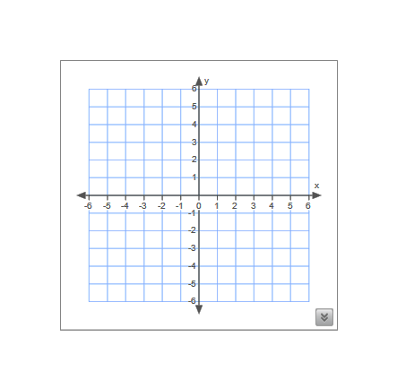
The point where a line intersects y-axis is called y-intercept.
The point where a line intersects x-axis is called x-intercept.
(0,3) is y-intercept of the line.
(4,0) is x-intercept of the line.
(0,3)
(4,0)
The y-coordinate of y-intercept is usually presented by a letter b.
In this case, b = 3

Slide 78
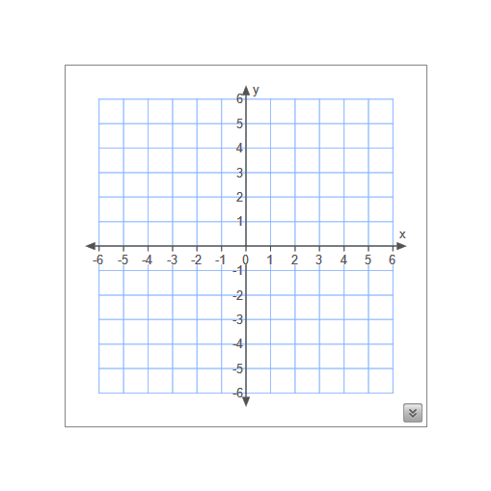
25
Find x- intercept.
A
(-2,3)
B
(3,0)
C
(-2,0)
D
(0,0)

Slide 79
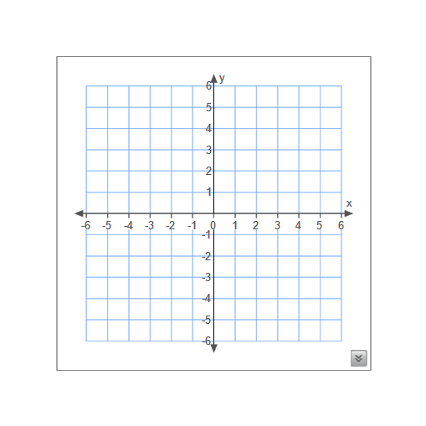
26
Find y-intercept.
A
(3,-2)
B
(-2,0)
C
(3,0)
D
(0,-2)

Slide 80
When the line passes through the origin, point (0,0) is a x-intercept and y-intercept at same time.
Note.
x-intercept always has
0 for y-coordinate,
as y-intercept always has
0 for y-coordinate.
For the red line:
x-intercept is (-1,0)
y-intercept is (0,-2)

Slide 81
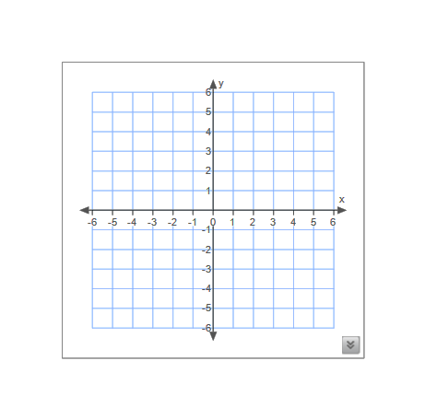
Example. Graph the line, find the slope and write the equation in a standard form for the line intercepts: ( 0,2) and (-3, 0).
Step 1. First recognize the x- and y-intercepts.
(0,2) is y-intercept, because ...
(-3,0) is x-intercept, because ...
(0,2)
(-3, 0)
Step 2. Graph the ordered pairs.
Step 3. Connect these points to get a line.

Slide 82
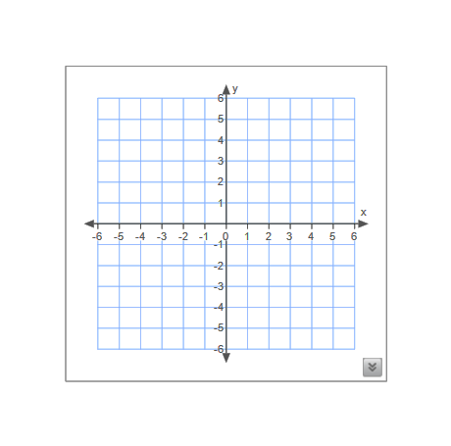
Step 4. Find the slope.
Method 1( the easiest one ): from the graph find rise and run.
Rise = 2, run = 3, slope =
2
3
(0,2)
Method 2: use the formula.
(-3, 0)
y₂ – y₁
Slope =
x₂ – x₁
(0,2)
(-3, 0)
0 – 2 -2 2
m = = =
-3 – 0 -3 3

Slide 83
Step 5. Now using any point on the line(given intercepts) and slope you can write the linear equation of this line in a standard form applying the known formula.
y – y₁= m(x – x₁)
(-3, 0)
, m =
2
3
2
3
(0,2)
, m =
2
3
x – y = -2

Slide 84
Now we would like to isolate y in the equation.
2
3
x – y = -2
2
3
You can recognize familiar numbers.
y = x + 2
slope = m
y-coordinate for y-intercept = b
This kind of equation is called a linear equation in slope-intercept form.
y = mx + b

Slide 85
Example. Find the slope and y-intercept for the line with the given equation in a standard form.
4x + 11y = -3
Our goal is to isolate y.
First we will subtract 4x from both sides of the equation.
4x + 11y = -3
11y = 4x – 3
Then we divide both sides of the equation by 11.
11y = 4x – 3
4
11
3
11
y = x -
slope
y-intercept

Slide 86
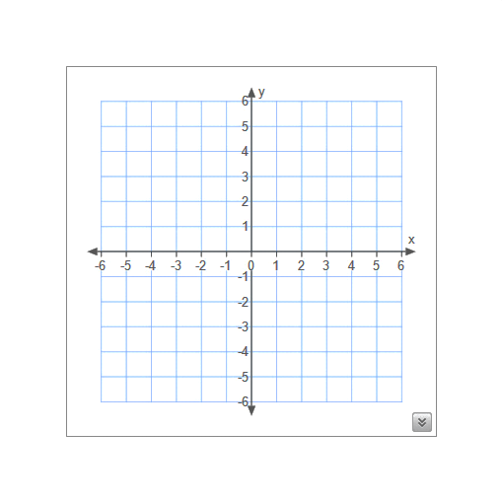
Example. Write an equation in the slope-intercept form for the given line.

Slide 87
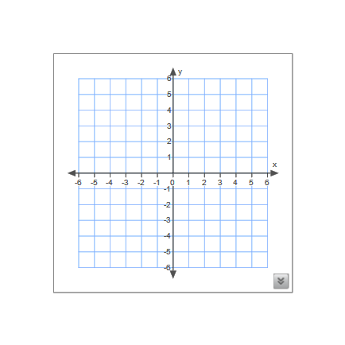
The given line in the coordinate plane is horizontal, so slope equals 0. The y-intercept is 2. The equation of this line is:
y = 2

Slide 88
The given line in the coordinate plane is vertical, so slope is undefined. There is no y-intercept. However, the x-intercept is -4.
The equation of this line is:
x = -4

Slide 89
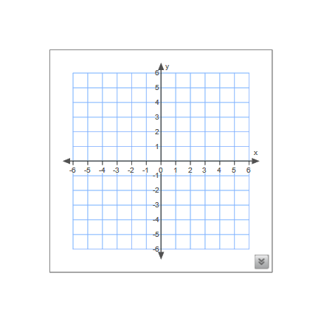
Example. Graph the line with the slope equals 0 and
y-intercept equals -2.

Slide 90
3
2
Example. Graph the line with the slope equals - and
y-intercept equals 1.

Slide 91
Example. Graph the line with no the slope and x-intercept equals 5.

Slide 92
Example. Write the equation in the slope-intercept form for the line that passes
trough points ( , - ) and (- , )
3 1 1 5
2 2 2 2
3 7
2 4
y = - x +
Click here

Slide 93
Example. Write the equation of the line that has y-intercept -5 and slope 0.
y = - 5
Click here

Slide 94
Example. Write the equation of the line that has x-intercept 12 and no slope.
Click here
x = 12

Slide 95
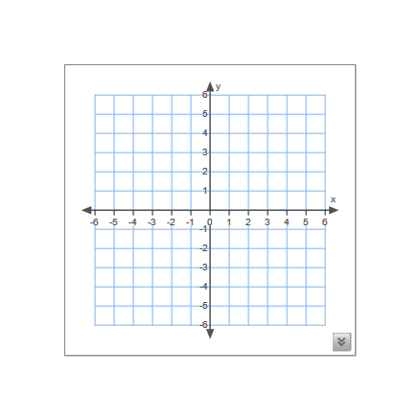
27
What is an equation of the line in the coordinate plane?
A
x = 0
B
y = 5
C
y = 0
D
x = 5

Slide 96
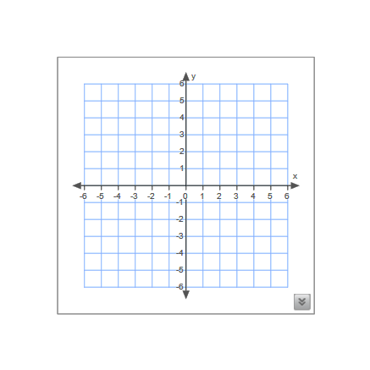
28
Which line has a negative slope?
A
red
B
green
C
blue
D
black

Slide 97
29
What is a slope of given line?
A
undefined
B
m = -5
C
m = 0
D
m = 5

Slide 98
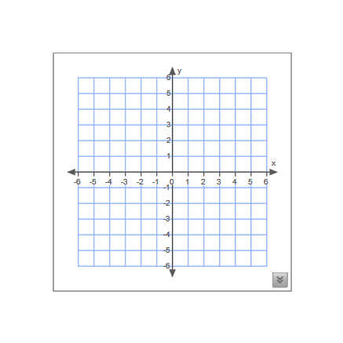
30
What is the slope of given line?
A
-2/3
B
3/2
C
-3
D
2

Slide 99
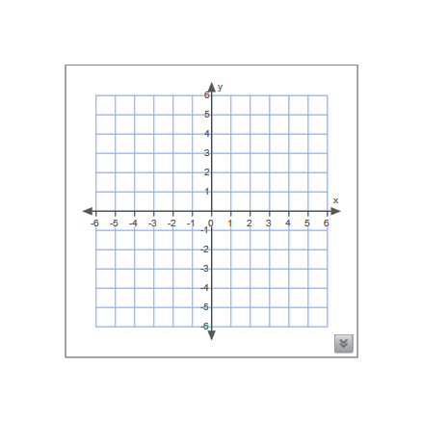
31
Which is an equation of the lie in the coordinate plane?
A
y = - 4/5x+2
B
y = 4/5x -2
C
y = 5/4x-2
D
y = - 5/4x+2

Slide 100
Slopes of Parallel Lines
Return to Table
of Contents

Slide 101
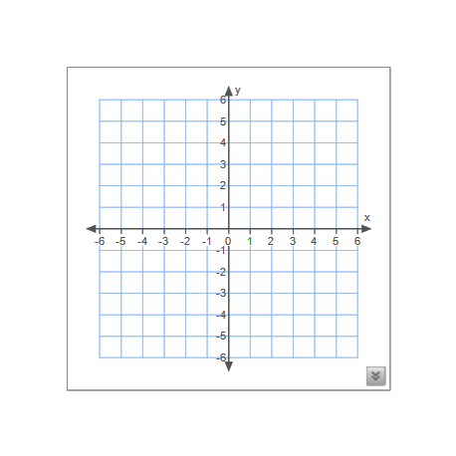
Look at those two vertical lines. The distance between them stays the same all the time, they will never intersect, so it is obvious - vertical lines are parallel. As well we remember that any vertical line has undefined slope, or, as we say, a vertical line has no slope.
All vertical lines have undefined slopes.

Slide 102
Now look at those three horizontal lines. The distance between them stays the same all the time, they will never intersect, so it is obvious - horizontal lines are parallel.
As well we remember that any horizontal line has slope equals 0.
All horizontal lines have slopes equals 0.

Slide 103
Now we can observe two nonvertical and nonhorizontal lines. You can see that they are on the same distance apart all the time, so they are parallel. And guess what? Both lines have the same slope equals .
1
2
Two lines have the same slopes if and only if they are parallel.

Slide 104
Example. Determine whether LM and NO are parallel lines.
L(3,-5), M(-6,1), N(4,-5), O(7,-7)
y₂ -y₁
Slope =
x₂-x₁
Find the slopes of LM and NO
using the formula of the slope.
Find the slope of LM.
Find the slope of NO.
1-(-5) 6 2
m = = = -
-6-3 -9 3
-7-(-5) -2 2
m = = = -
7-4 3 3
Lines LM and NO have equal slopes, so these lines are parallel.

Slide 105

Example. Find an equation of the line passing through the point (-4,5) and parallel to the line whose equation is -3x + 2y = -1
First, we rewrite the given equation
in the slope-intercept form.
m =
3
2
(-4,5)
-3x + 2y = -1
Now we will use the point-slope formula.
2y = 3x – 1
y-y₁= m(x-x₁)
3
2
1
2
y = x –
3
2
y – 5 = (x – (-4))
slope
3
2
y – 5 = x + 2
3
2
y = x + 7

Slide 106
32
What is an equation of the line passing through the point (6, -2) and parallel to the line whose equation is y = 2x – 3
A
y = 2x + 2
B
y = -2x – 10
C
y = 1/2x – 5
D
y = 2x – 14

Slide 107
33
What is the equation of a line that is parallel to the line which is represented by the equation y = -x – 22
A
x – y = 22
B
y – x = 22
C
y + x = -17
D
2y + x = -22

Slide 108
34
Two lines are represented by equations
-3y = 12x – 14 and y = kx + 14.
For which value of k will the lines be parallel?
A
12
B
-14
C
3
D
-4

Slide 109
35
Which equation represents a line parallel to the line whose equation is 3y + 4x = 21?
A
4y + 3x = 21
B
3y – 4x = 22
C
3y = 4x + 21
D
12y + 16x = 12

Slide 110
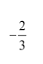
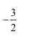
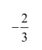
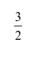

36
What is an equation of the line that passes through point (6,-2) and is parallel to the line whose equation is y = x + 5
A
y = x + 5
B
y = x + 2
C
y = - x + 2
D
y = -2x + 2
E
y = x

Slide 111
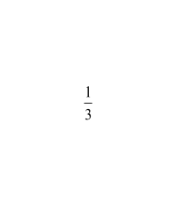
37
What is an equation of the line that passes the point (5,-2) and is parallel to the line 9x-3y=12?
A
y = 3x – 17
B
y = x –
C
y = - x +
D
y = -3x + 15

Slide 112
Perpendicular Lines and Angles
Return to Table
of Contents

Slide 113
Lines p and n are intersecting lines, so they are coplanar. You may notice that these two lines intersect in very special way - they form 4 right angles. These two intersecting lines are called perpendicular lines.
Definition of
Perpendicular Lines
Two lines are perpendicular if and only if they are intersecting to form 4 right angles.
Two perpendicular lines are always coplanar. In geometry, the symbol ⊥
p
n
means is perpendicular to .
p ⊥ n means line p is perpendicular to line n.

Slide 114
Lines n and p are parallel as shown on the diagram. Then m ∠ABC = m∠DEF, because they are corresponding angles.
A
n
B
C
D
p
If AE ⊥ EF, then ∠DEF=90⁰.
E
F
So, m ∠ABC = 90⁰. Therefore, we can conclude a theorem.
Perpendicular Transversal
Theorem
In a plane, if a line is perpendicular to one of two parallel lines, then it is perpendicular to the other.

Slide 115
38
In the plane, line a is parallel to line b, line b is parallel to line c, and line d is perpendicular to line a. Which is following Must be true?
A
d || b
B
c || d
C
d ⊥ a

Slide 116
39
In the plane, line k is perpendicular to line m, line m is parallel to line n, n is parallel to line o. Which is following Must be true?
A
k || o
B
k ⊥ o
C
neither

Slide 117

40
Find the value of x.
(6x + 18)⁰

Slide 118
Constructing Perpendicular Lines
Return to Table
of Contents

Slide 119
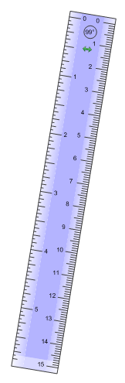
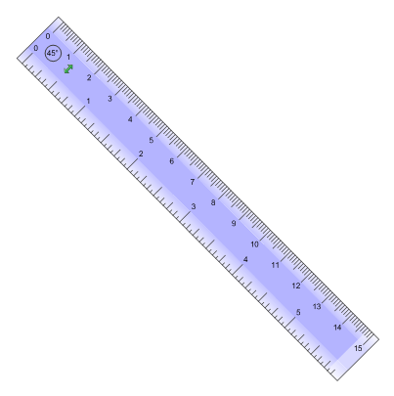
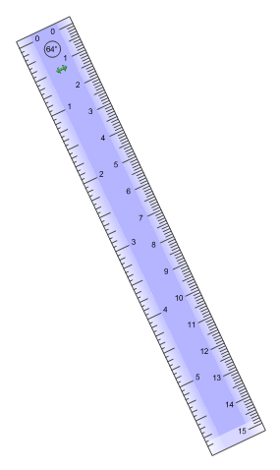

The Distance between a Point and a Line
The distance from a line to a point not on the line is the length of the segment perpendicular to the line from the point.

Slide 120
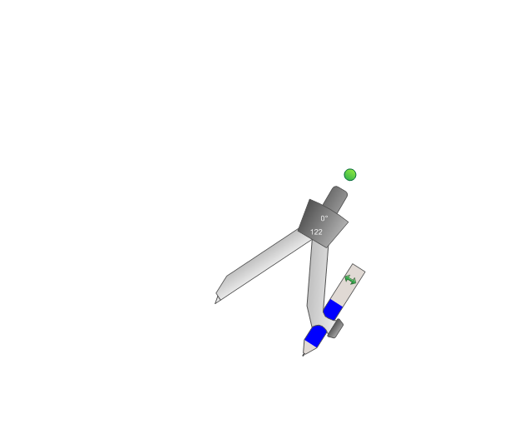
Now we will construct a line through a point perpendicular to a given line.
Given: Line AB and point C not on the line.
C
C
A
B
Step 1. Place the compass on the point C. Set the compass width wide enough that you will be able to draw two arcs on the AB.
A
B
C
Step 2. Label two points on the line AB as points D and E.
A
B
D
E

Slide 121
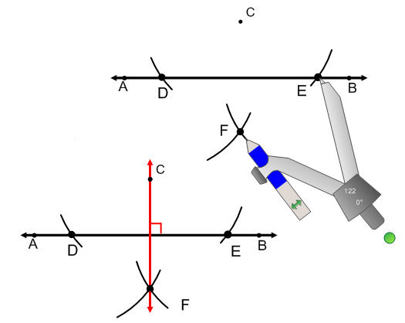

Step 3. From each point D and E with the same compass width
draw two arcs below the line AB, so the arcs will intersect.
Step 4. Name point of intersection
of two arcs as point F.
Step 5. Connect points C and F.
The line CF is perpendicular to line AB.

Slide 122
Example. Construct a perpendicular line from the point P to the line a. Write down each step you are performing.
P
Step 1.
Step 2.
Step 3.
a
Step 4.
Step 5.

Slide 123
41
State which two lines are parallel.
c
A
a || b
B
c || d
d
C
neither
a
b

Slide 124
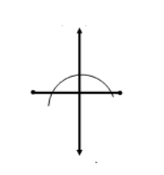
42
Which diagram represents the construction of the perpendicular bisector of MN?
A
B
C
D

Slide 125
43
State which two lines are parallel.
B
A
AC || ED
B
AE || CD
F
C
AB || DF
C
27⁰
34⁰
63⁰
56⁰
A
48⁰
51⁰
D
E

Slide 126
Slopes of Perpendicular Lines
Return to Table
of Contents

Slide 127
First, let review some information from Algebra.
How do we call those two numbers?
1
3
and 3?
-4 and
1
4
5 and -5?
reciprocals
negative reciprocals
opposites
11
5
5
11
and -
7
6
and
6
7
negative reciprocals
- 11 and 11?
1 and -1
reciprocals
opposites
opposites
negative reciprocals

Slide 128
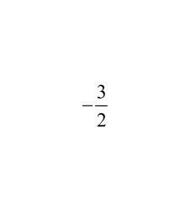
44
Which is negative reciprocal of ?
A
3/2
B
-3/2
C
2/3
D
-2/3

Slide 129
45
Which is negative reciprocal of - 14?
A
1/14
B
- 1/14
C
14
D
-14

Slide 130
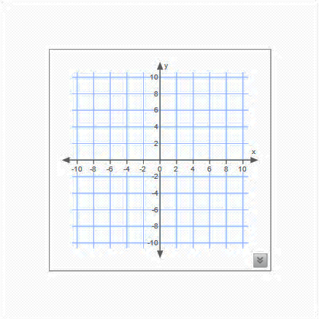
You definitely remember that parallel lines have the same slope. What about perpendicular lines? Lets make a guess.
Blue and red lines are drawn to be perpendicular. Can you calculate the slopes of each line?
First, it is obvious that perpendicular lines do not have the same slope. Why?
Because the blue line falls, so it has negative slope. And the red line raises, so its slope is positive.
2
3
3
2
Slope of blue line = - , slope of red line =
Can you make any conclusion?

Slide 131
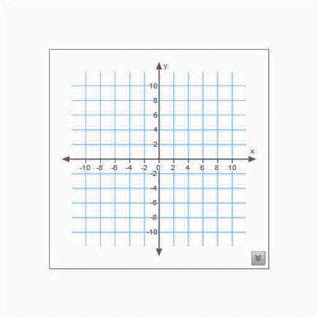
Blue and red lines are drawn to be perpendicular.
Can you calculate the slopes of each line?
Remember: 1 and - 1 are negative reciprocals.
m=1
m=-1
Two lines are perpendicular if and only if their slopes are negative reciprocals.

Slide 132
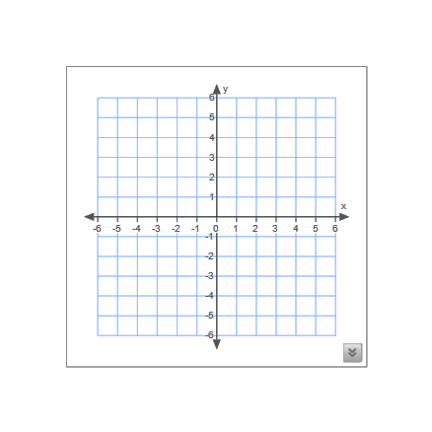
m=0
Any horizontal line and vertical line are always perpendicular.
no slope

Slide 133
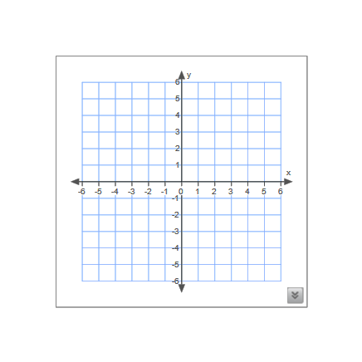
46
Are these two line perpendicular?
Yes
No

Slide 134

47
These two lines are ...
A
perpendicular
B
parallel
C
neither

Slide 135
Example. Write an equation for the line through (-2,5) and perpendicular to the line y = x – 4.
2
3
3
2
First, we need to find the slope of the perpendicular line: m =
Then using a given point and a point slope formula we will write an equation of the perpendicular line passing through the given point.
y – y₁ = m(x – x₁)
3
2
y – 5 = (x – (-2))
3
2
y – 5 = (x + 2)
3
2
y = x + 8

Slide 136

48
The lines represented by the equations
2y + x = -3 and 10y + 4x = -15 are ...
A
parallel
B
perpendicular
C
neither parallel nor perpendicular
D
the same line

Slide 137
49
What is the slope of a line perpendicular to the line whose equation is 12y – 6x = 11
A
-2
B
1/2
C
2
D
-1/2

Slide 138
50
What is an equation of the line that contains the point (-4,1) and is perpendicular to the line whose equation is y = -2x – 3?
A
y = 2x + 1
B
y = 1/2x + 3
C
y = -2x – 1
D
y = -1/2x + 3

Slide 139
51
What is the slope of a line that is perpendicular to the line whose equation is 4x – 5y = 20?
A
-5/4
B
-4/5
C
4
D
-5

Slide 140
52
Two lines are represented by the given equations. What would be the best statement to describes these two lines?
2x + 5y = 15 5(x + 1) = -2y + 20
A
The lines are parallel.
B
The lines are same line.
C
The lines are perpendicular.
D
The lines intersect at an angle other than 90 .

Slide 141

Example. Find the distance between parallel lines with the given equations.
x = -3
x = 1.25

Slide 142
53
Find the distance between parallel lines with given equations.
y = -1/5
y = -2

Slide 143

Example. Graph the given linear equation and plot the ordered pair. Then construct the perpendicular from the given point to the line and find the distance from the point to the line.
-3x + 2y = -8 (-1,1)
First, we represent the given equation in the slope-intercept and we will graph this line.
3
2
y = x – 4
Then we will plot the ordered pair (-1,1)
The slope of the perpendicular line equals -
3
2
2
3
y= x - 4
(-1,1)
Find the equation of the perpendicular line:
2
3
y – 1 = - (x – (-1))
2
3
y – 1 = - (x +1)
2
3
1
3
y = - x +

Slide 144
From the diagram, it seems that the point of intersection of two lines is (2,-1). How can we prove it?
3
2
2
3
1
3
y = x – 4
y = - x +
When two lines intersect, they intersect at one point, so their x and y coordinates are the same. So, we can set these two equations equal.
3
2
2
3
1
3
x – 4
= - x +
3
2
2
3
1
3
(-1,1)
x
+ x =
+ 4
(2,-1)
13
6
26
6
x =
x = 2
Now we can substitute value for x in any of two equations in order to get value for y.
3
2
y = 2 – 4
y = -1
(2,-1) is a point of intersection of two lines.

Slide 145
Now we can easily find the distance between two points.
Lets recall the distance formula:
1
d = √ (x₂ – x₁)² + (y₂ – y₁)²
(-1,1)
(2,-1)
(-1,1)
d = √ (2 – (-1))² + (-1 – 1)²
(2,-1)
d = √ 9 + 4
d = √ 13
This is a shortest distance between
a point and a given line.

Slide 146
Now, try on your own.
Example. Graph the given linear equation and plot the ordered pair. Then construct the perpendicular from the given point to the line and find the distance from the point to the line.
6x + 3y = 9 (5,3)
Answer:
d = 2√5

Slide 147
Proofs Involving Parallel and
Perpendicular Lines
Return to Table
of Contents

Slide 148
In order to deduce any theorem or fact we are using definitions, properties and postulates; statements that are accepted without proof. We call them justifications or reasons. When writing proofs, we can use the previously proven theorems as justifications as well.
How to Make a Good Proof
List what you
need to prove
Click here
State the theorem or fact that needed to be proven
Click here
Draw a diagram,
if possible
Click here
List all statements and reasons that lead from the given information to the statement that is to be proved
Click here
List the given
information
Click here

Slide 149
Now we recall some properties and postulates that would be extremely useful to make proofs involving Parallel and Perpendicular Lines.
Properties of Equality
ALGEBRA PROPERTIES
Addition Property. If a=b and c=d, then a+c=b+c
Subtraction Property. If a=b and c=d, then a-c=b-c
Multiplication Property. If a=b, then ca=cb
Division Property. If a=b and c≠0, then a/c=b/c
Substitution Property. If a=b, then either a or b may be substituted for the other in any equation(or inequality).
Reflexive Property. a=a
Symmetric Property. If a=b, then b=a.
Transitive Property. If a=b and b=c, then a=c.
Distributive Property. a(b + c)=ab + ac

Slide 150
Properties of Congruence
Reflexive Property. AB ≅ AB ∠ A ≅ ∠A
Symmetric Property. If AB ≅ CD, then CD ≅ AB. If ∠A ≅ ∠B, then ∠B ≅ ∠A
Transitive Property. If AB ≅ CD and CD ≅ EF, then AB ≅ EF. If ∠A ≅ ∠B and ∠B ≅ ∠C, then ∠A ≅ ∠C.
GEOMETRY PROPERTIES
Postulate
If two parallel lines are cut by transversal, then corresponding angles are congruent.
Definition of
Vertical Angles
Vertical angles are congruent.
Congruent Supplements
Theorem
If two angles are supplements of the same angle, then two angles are congruent.
Congruent Complements
Theorem
If two angles are complements of the same angle, then two angles are congruent.

Slide 151
Alternate Interior
Angles Theorem
If two parallel lines are cut by transversal, then alternate interior angles are congruent.
n
Given:
Prove:
k || m
k || m
∠2 ≅ ∠3
1
k
Statement
Justification
2
3
m
1) k || m
∠1 ≅ ∠2
3) ∠1 ≅ ∠3
4) ∠2 ≅ ∠3
1) Given
2) Def. of Vertical Angles
3) Corresponding Angles Postulate
4) Transitive Property

Slide 152
Same-side Interior Angles Theorem
If two parallel lines are cut by transversal, then same-side interior angles are supplementary.
Given:
Prove:
k || m
n
m∠ 2 + m∠3 = 180⁰
k || m
1
k
Statement
Justification
2
3
m
1) k || m
2) ∠1 ≅ ∠3
3)
4)
1) Given
2) Corresponding Angles Postulate
3) Def. of Supplementary Angles
4) Substitution Property
m ∠ 1 + m∠2 = 180⁰
m ∠ 2 + m∠3 = 180⁰

Slide 153
Example. If lines k and m are parallel, prove that ∠2 and ∠5 are supplementary.
n
k || m
Given:
Prove:
k || m
m ∠ 2 + m∠5 = 180⁰
2
1
3
k
Statement
Justification
4
6
5
m
1) k || m
2)
3)
4)
7
8
Given
2) Def. of Vertical Angles
3) Theorem 2 ( s.-s. interior angles)
4) Substitution Property
∠2 ≅ ∠4
m ∠ 4 + m∠5 = 180⁰
m ∠ 2 + m∠5 = 180⁰

Slide 154
Would you be able to prove the same statement by different method?
Example. If lines k and m are parallel, prove that ∠ 2 and ∠5 are supplementary.
Given:
Prove:
k || m
m ∠ 2 + m∠5 = 180⁰
Statement
Justification
n
k || m
1) k || m
2)
3)
4)
1) Given
2)
3)
4)
2
1
3
k
4
6
5
m
7
8

Slide 155





A
B
1
Given:
Prove:
AB || CD
∠1 ≅ ∠2, ∠3 ≅ ∠4
C
2
CB || ED
3
4
D
Statement
Justification
E
1)
2)
3)
4)
5)
AB || CD
1) Given
2) Corresponding angles postulate
3) Transitive property
4) Substitution property
5) Corresponding angles postulate
∠1 ≅ ∠2, ∠3 ≅ ∠4
∠1 ≅ ∠3
∠2 ≅ ∠3
∠2 ≅ ∠4
CB || ED

Slide 156
a
b
Given:
Prove:
a||b, c||d
c
∠1 ≅ ∠3
4
1
Statement
Justification
3
2
d
1) c||d
2)
3)
4)
5)
1) Given
2)
3) Given
4)
5)
4
4
4
4
4
4
4
4
4
4
4
4
4
4
4
4
4
4
4
4
4
3
4
3
3
3
3
3
3
3
3
3
3
3
3
3
3
3
3
3
3
3
3
3
≅
≅
≅
≅
≅
≅
≅
≅
≅
≅
≅
≅
≅
≅
≅
≅
≅
≅
≅
≅
≅
≅
Congruent Supplements
Theorem
Congruent Supplements
Theorem
Congruent Supplements
Theorem
Congruent Supplements
Theorem
Congruent Supplements
Theorem
Congruent Supplements
Theorem
Congruent Supplements
Theorem
Congruent Supplements
Theorem
Congruent Supplements
Theorem
Congruent Supplements
Theorem
Congruent Supplements
Theorem
Congruent Supplements
Theorem
Congruent Supplements
Theorem
Congruent Supplements
Theorem
Congruent Supplements
Theorem
Congruent Supplements
Theorem
Congruent Supplements
Theorem
Congruent Supplements
Theorem
Congruent Supplements
Theorem
Congruent Supplements
Theorem
Congruent Supplements
Theorem
Congruent Supplements
Theorem
m 1 + m 2=180⁰
m 1 + m 2=180⁰
m 1 + m 2=180⁰
m 1 + m 2=180⁰
m 1 + m 2=180⁰
m 1 + m 2=180⁰
m 1 + m 2=180⁰
m 1 + m 2=180⁰
m 1 + m 2=180⁰
m 1 + m 2=180⁰
m 1 + m 2=180⁰
m 1 + m 2=180⁰
m 1 + m 2=180⁰
m 1 + m 2=180⁰
m 1 + m 2=180⁰
m 1 + m 2=180⁰
m 1 + m 2=180⁰
m 1 + m 2=180⁰
m 1 + m 2=180⁰
m 1 + m 2=180⁰
m 1 + m 2=180⁰
m 1 + m 2=180⁰
Theorem 1( Alternate
interior angles)
Theorem 1( Alternate
interior angles)
Theorem 1( Alternate
interior angles)
Theorem 1( Alternate
interior angles)
Theorem 1( Alternate
interior angles)
Theorem 1( Alternate
interior angles)
Theorem 1( Alternate
interior angles)
Theorem 1( Alternate
interior angles)
Theorem 1( Alternate
interior angles)
Theorem 1( Alternate
interior angles)
Theorem 1( Alternate
interior angles)
Theorem 1( Alternate
interior angles)
Theorem 1( Alternate
interior angles)
Theorem 1( Alternate
interior angles)
Theorem 1( Alternate
interior angles)
Theorem 1( Alternate
interior angles)
Theorem 1( Alternate
interior angles)
Theorem 1( Alternate
interior angles)
Theorem 1( Alternate
interior angles)
Theorem 1( Alternate
interior angles)
Theorem 1( Alternate
interior angles)
Theorem 1( Alternate
interior angles)
m 3+ m 2=180⁰
m 3+ m 2=180⁰
m 3+ m 2=180⁰
m 3+ m 2=180⁰
m 3+ m 2=180⁰
m 3+ m 2=180⁰
m 3+ m 2=180⁰
m 3+ m 2=180⁰
m 3+ m 2=180⁰
m 3+ m 2=180⁰
m 3+ m 2=180⁰
m 3+ m 2=180⁰
m 3+ m 2=180⁰
m 3+ m 2=180⁰
m 3+ m 2=180⁰
m 3+ m 2=180⁰
m 3+ m 2=180⁰
m 3+ m 2=180⁰
m 3+ m 2=180⁰
m 3+ m 2=180⁰
m 3+ m 2=180⁰
m 3+ m 2=180⁰
Corresponding Angles
Postulates
Corresponding Angles
Postulates
Corresponding Angles
Postulates
Corresponding Angles
Postulates
Corresponding Angles
Postulates
Corresponding Angles
Postulates
Corresponding Angles
Postulates
Corresponding Angles
Postulates
Corresponding Angles
Postulates
Corresponding Angles
Postulates
Corresponding Angles
Postulates
Corresponding Angles
Postulates
Corresponding Angles
Postulates
Corresponding Angles
Postulates
Corresponding Angles
Postulates
Corresponding Angles
Postulates
Corresponding Angles
Postulates
Corresponding Angles
Postulates
Corresponding Angles
Postulates
Corresponding Angles
Postulates
Corresponding Angles
Postulates
Corresponding Angles
Postulates
Theorem 2( Same-side
interior angles)
Theorem 2( Same-side
interior angles)
Theorem 2( Same-side
interior angles)
Theorem 2( Same-side
interior angles)
Theorem 2( Same-side
interior angles)
Theorem 2( Same-side
interior angles)
Theorem 2( Same-side
interior angles)
Theorem 2( Same-side
interior angles)
Theorem 2( Same-side
interior angles)
Theorem 2( Same-side
interior angles)
Theorem 2( Same-side
interior angles)
Theorem 2( Same-side
interior angles)
Theorem 2( Same-side
interior angles)
Theorem 2( Same-side
interior angles)
Theorem 2( Same-side
interior angles)
Theorem 2( Same-side
interior angles)
Theorem 2( Same-side
interior angles)
Theorem 2( Same-side
interior angles)
Theorem 2( Same-side
interior angles)
Theorem 2( Same-side
interior angles)
Theorem 2( Same-side
interior angles)
Theorem 2( Same-side
interior angles)
Congruent Complements
Theorem
Congruent Complements
Theorem
Congruent Complements
Theorem
Congruent Complements
Theorem
Congruent Complements
Theorem
Congruent Complements
Theorem
Congruent Complements
Theorem
Congruent Complements
Theorem
Congruent Complements
Theorem
Congruent Complements
Theorem
Congruent Complements
Theorem
Congruent Complements
Theorem
Congruent Complements
Theorem
Congruent Complements
Theorem
Congruent Complements
Theorem
Congruent Complements
Theorem
Congruent Complements
Theorem
Congruent Complements
Theorem
Congruent Complements
Theorem
Congruent Complements
Theorem
Congruent Complements
Theorem
Congruent Complements
Theorem

Slide 157
Prove: If ∠1 ≅ ∠4, then lines k and m are parallel.
Given:
Prove:
∠1 ≅ ∠4
k || m
Statement
Justification
1)
1) Given
n
∠1 ≅ ∠4
2
1
3
k
m
4

Slide 158
Perpendicular Transversal
Theorem
In a plane, if a line is perpendicular to one of two parallel lines, then it is perpendicular to the other.
Given:
Prove:
n ⊥ k, n ⊥ m
k || m
Statement
Justification
1)
2)
3)
4)
n ⊥ k, n ⊥ m
1) Given
2)
3)
4)
1
2
k
m∠1 = m∠2 = 90⁰
n
∠1 ≅ ∠2
m
k || m

Slide 159
Three Parallel
Lines Theorem
If two lines are parallel to the same line,
then they are parallel to each other.
Given:
Prove:
n || k, k || m
n || m
Statement
Justification
1)
n || k
1) Given
n
1
k
2
m
3

Slide 160


You are completely on your own. You are smart, you can do it
Given:
Prove:
∠5 ≅ ∠6
, AB ||DE
DE is a bisector of ∠ BDC
B
Statement
Justification
5
4
A
6
E
3
2
1
D
C

